Slide 1

Operating Systems
Lecture 37
Syed Mansoor Sarwar

Slide 2
Agenda for Today
Review of previous lecture
Memory Management in Intel 80386
Virtual Memory
Demand Paging
Page Fault
Performance of Demand Paging
Process Creation

Slide 3
Review of Lecture 36
Paged segmentation
Examples of paged segmentation: MULTICS under GE 345 and OS/2, Windows, and Linux under Intel CPUs

Slide 4

Paged Segmentation

Slide 5
MULTICS Example
15 3921
5096
3921
3 849
12
12 849
13137

Slide 6
Intel 80386 Example
16-bit Selector
32-bit Offset
13-bit Segment #
s
g
p
2-bit field for specifying the privilege level
1-bit field to specify GDT or LDT

Slide 7
Intel 80386 Example
Protected Mode
  2⁴⁸ bytes virtual address space
  2³² bytes linear address space
  Max segment size = 4 GB
  Max segments / process = 16K
  Six CPU registers allow access to six segments at a time

Slide 8
Intel 80386 Example
Protected Mode
Selector is used to index a segment descriptor table to obtain an 8-byte segment descriptor entry. Base address and offset are added to get a 32-bit linear address, which is partitioned into p1, p2, and d for supporting 2-level paging.

Slide 9

Intel 80386 Example

Slide 10
Fundamentals
Virtual Memory: A technique that allows a process to execute in the main memory space which is smaller than the process size
Only a part of a process needs to be loaded in the main memory for execution

Slide 11
Fundamentals
Sharing of address space among several processes
Efficient process creation—fork() and vfork()
Memory mapped files
Support needed for virtual memory

Slide 12
Fundamentals
Virtual memory can be implemented via:
  Demand paging
  Demand segmentation

Slide 13
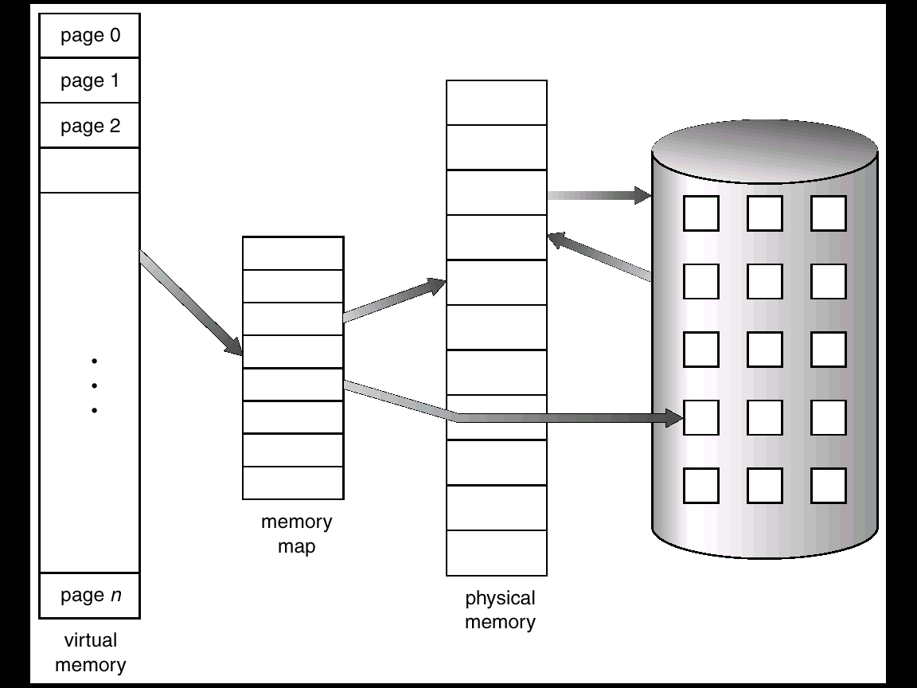
The Basic Idea
Secondary Storage

Slide 14
Demand Paging
Bring a page into memory only when it is needed
  Potentially less I/O needed
  Potentially less memory needed
  Faster response
  Higher degree of multiprogramming

Slide 15
Demand Paging
Page is needed ⇒ a reference is made to it
  Invalid reference ⇒ abort
  Not-in-memory
  ⇒ page fault
  ⇒ bring page to memory
  No free frame ⇒ swapping (out and in)

Slide 16
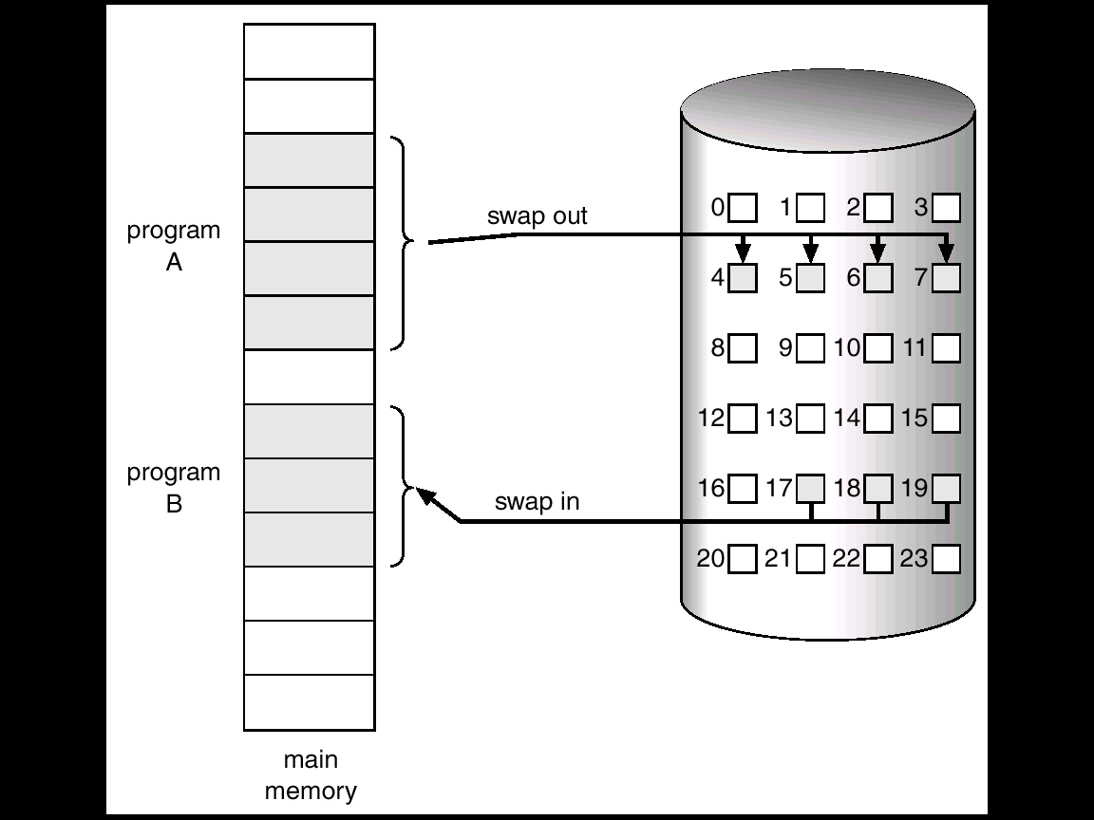
Swapping

Slide 17
Valid-Invalid Bit
With each page table entry a valid–invalid bit is associated
(1 ⇒ in-memory, 0 ⇒ not-in-memory)
Initially valid–invalid but is set to 0 on all entries

Slide 18
Valid-Invalid Bit
During address translation, if valid–invalid bit in page table entry is 0 ⇒ page fault.
Frame #
valid-invalid bit
1
1
1
1
0

0
0
page table

Slide 19

Demand Paging

Slide 20
Page Fault
If there is ever a reference to a page, first reference will trap to
OS ⇒ page fault
OS decides
  Invalid reference ⇒ trap to OS ⇒ abort process
  Just not in memory ⇒ page fault ⇒ service page fault

Slide 21
Page Fault
Allocate an empty frame
Locate the desired page on disk
Swap in the desired page into the newly allocated frame.
Store the frame number in the appropriate page table entry
Reset tables; set valid/invalid bit to 1
Restart instruction

Slide 22

Servicing a Page Fault

Slide 23
Restarting Instruction
Problems with restarting instructions that cause page faults
  Auto increment/decrement location
  Block move

Slide 24
Block Move
0
1
Destination String
Source String
2
3
…

Slide 25
Block Move
0
1
Destination String
Source String
2
3
…

Slide 26
Performance of Demand Paging
Page Fault Rate 0 ≤ p ≤ 1.0
  if p = 0 no page faults
  if p = 1, every reference is a fault

Slide 27
Performance of Demand Paging
Effective Access Time (EAT)
EAT = (1 – p) x memory access
+ p (page fault service time)

Slide 28
Page Fault Service
Trap to OS
Context switch
Locate the vector for the given trap
Check that the page reference was legal and determine the location of the desired page on the disk
Locate a free frame
Issue a disk read into this frame

Slide 29
Page Fault Service
While waiting for disk read to complete, schedule another process
Interrupt from the disk controller indicating completion of disk read
Correct the page table (frame number, in-memory bit, etc.)
Put process in the ready queue
Restart process with the instruction that caused page fault

Slide 30
Example
Memory access time = 100 nanosec
Page fault service time = 25 millisec
T_{effective} = (1 - p) x 100 + p (25 milli)
= (1 - p) x 100 + p (25000000)
= 100 + 24999900 x p
If one access out of 1000 causes a page fault, effective access time is 25 microseconds, a slowdown by a factor of 250.

Slide 31
Recap of Lecture
Background
Demand Paging
Page fault
Performance of Demand Paging

Slide 32
Operating Systems
Lecture 37
Syed Mansoor Sarwar

